Slide 1
English 8
UNIT 2 . LIFE IN THE COUNTRYSISE
PERIOD 15: LOOKING BACK AND PROJECT
Welcome to our class
Teacher: Nguyen Thi Hien
Long Bien Secondary School

Slide 2
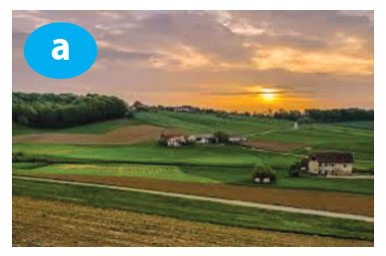
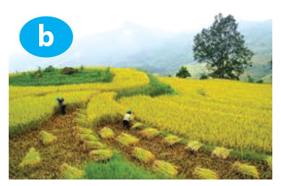
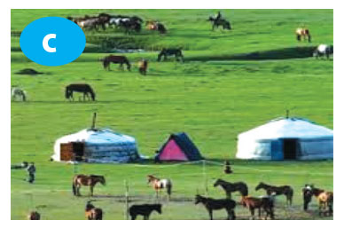
Vocabulary
1. Use the words and phrases in the box to describe the pictures. Some words/ phrases may be used for more than one picture.
peaceful
vast
quiet
pasture
paddy field
quiet
colourful
paddy field
harvest time
rice
peaceful
vast
quiet
nomadic life
inconvenient
ger
pasture
cattle
horses

Slide 3
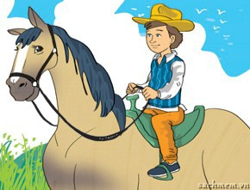
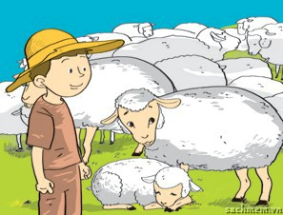
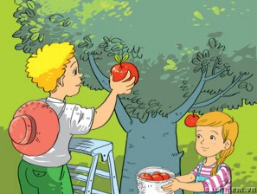
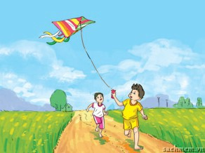
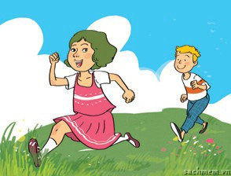
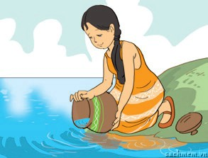
2. Look at each picture and write a sentence describing what each person is doing. Use the verbs in brackets.
1. (ride)
A boy is riding a horse.
2. (herd)
A man is herding his cattle / sheep.
3. (pick)
A girl is picking apples (from an apple tree).
4. (fly)
A boy is flying a kite.
5. (run around)
6. (collect)
The children are running around in the fields / countryside.
A woman is collecting water from the river.

Slide 4
3. Look at the pictures and complete the sentences, using suitable comparative forms of the adverbs in brackets.
1. A lion runs __________ a horse. (fast)
faster than
earlier than
2. The Great Wall was built __________ the White House. (early)

Slide 5
better
3. Homes in the city are often _______ furnished _____ those in the countryside. (well)
4. A racing driver drives __________________ a normal motorist. (skillfully)
than
more skillfully than
more beautifully
5. A house is ______________ decorated at New Year _____ during the year. (beautifully)
than

Slide 6
4. Read the situations and complete the sentences with suitable forms of the adverbs in brackets.
A horse can run 80km/hr while a camel can only run 12km/hr. (fast)
→ A horse can run ____________________.
According to a survey, 75% of the population in the countryside are happy with their life. This rate in the city is only 47%. (happily)
→ People in the countryside live ______________________________.
Unlike many other jobs, farmers depend heavily on the weather. (heavily)
→ Farmers depend ____________________________________________________.
We are both bad at swimming but I’m better than my sister. (badly)
→ My sister swims ____________________.
faster than a camel
more happily than those in the city
more heavily on the weather than people in many other jobs
worse than I do

Slide 7
communication
5. Work in groups.
You are planning a trip to the countryside. Work together and answer the question:
What will you do during the trip to the countryside?
Write the answer in the table below.
Person’s name | Activity
1.
2.
3.
4.
Report your findings to the class.

Slide 8
Finished! Now I can... | ✔ | ✔✔ | ✔✔✔
use words/ phrases to describe life in the countryside use comparative forms of adverbs of manner pronounce words containing cluster /bl/ and /cl/ corectly in isolation and in sentences talk and write about life in the countryside and ways it has changed

Slide 9
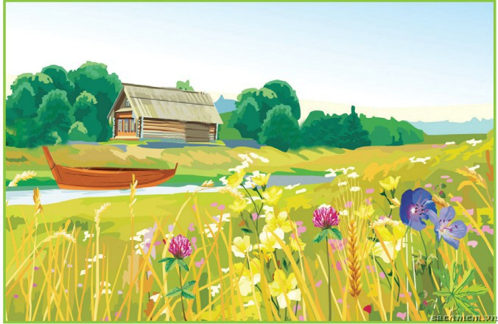
project
Work in groups of four or five. Take turns to draw a group picture of a place you would like to live in the countryside. Then make a list of:
the things you have in your picture
the activities you can do there
Show your drawing to the class and talk about it.

Slide 10
Example:
1.
a wooden house
a beautiful river
a boat
a field of wild flower
2.
biking along the river
picking wild flowers
swimming in the river
boating on the river

